Slide 1
Joys of JS
Chris Human ©2023

Slide 2
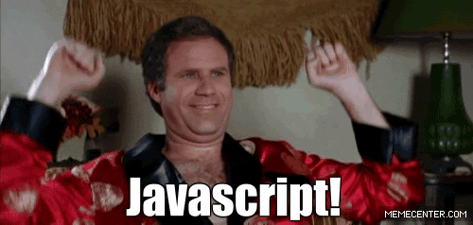
OMG JavaScript!
Prepare to become true coders!

Slide 3
How to Learn JS

Slide 4
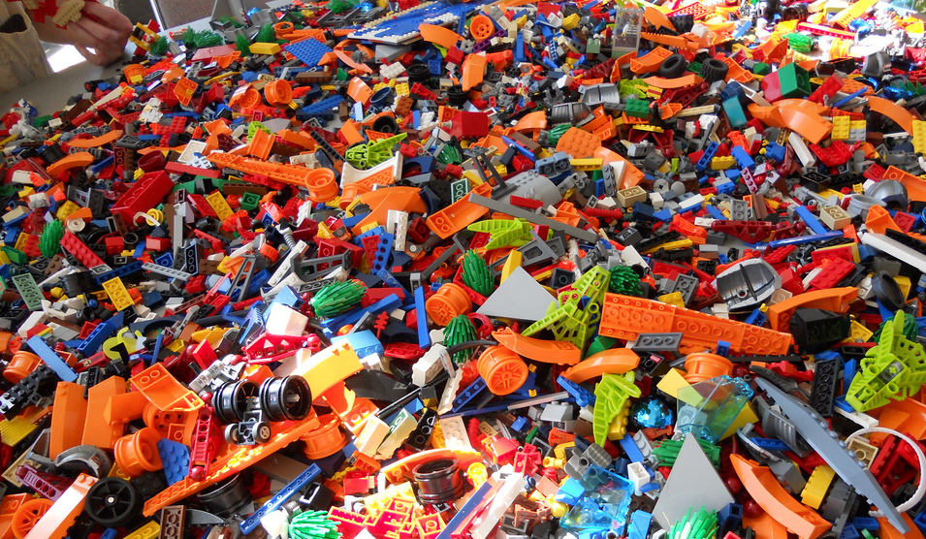
Your Brain on JavaScript…

Slide 5
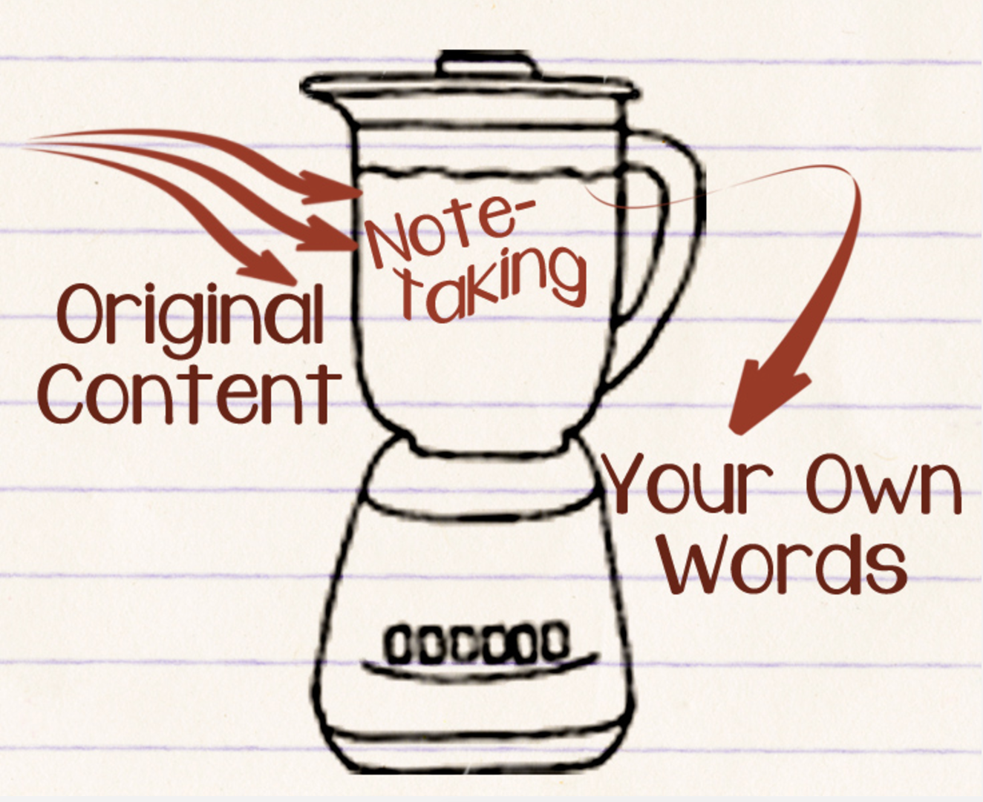
Time to Take Notes…

Slide 6
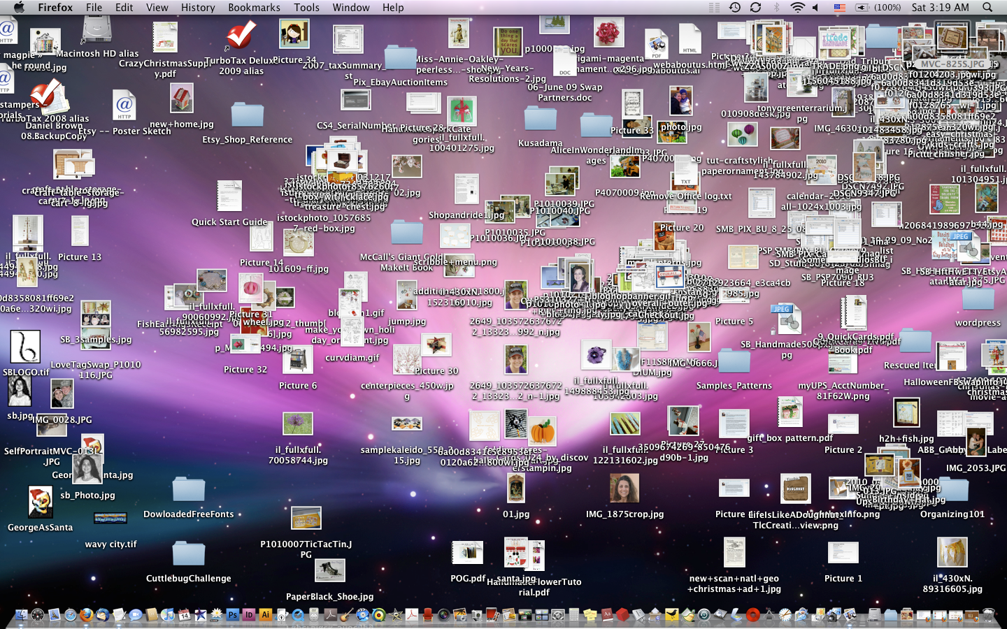
Keep Organized!

Slide 7
Overall Tips
Review Immediately: We’ll be building upon these concepts quickly. The firmer your grasp now, the better off you’ll be.
Re-do the exercises in class: Don’t just re-read! Actually spend the time to re-do them from scratch on your own.
Get Help: Ask conceptual questions. Ask specific questions. Just keep asking questions!
Don’t be Afraid: You will get this. It will take time, but you will get this. Just keep at it. Patience will pay off.

Slide 8
Your Turn!
Activity: Code Dissection
Suggested Time: 10 min.
Assignment:
Open the index.html file, from the class repo, in Chrome and observe what happens
Try looking at the code and explaining, in your own words, how it works
P.S. - We have not covered JavaScript before, but a big part of being a developer is examining/learning on the fly!

Slide 9
What is JavaScript?

Slide 10

JavaScript Definition
JavaScript is the third of the three fundamental programming languages of the modern web (along with HTML, CSS).
JavaScript allows developers to create dynamic web applications capable of taking in user inputs, changing what’s displayed to users, animating elements, and much more.
JavaScript is the only major client-side programming language (runs on the user’s computer rather than a server.

Slide 11
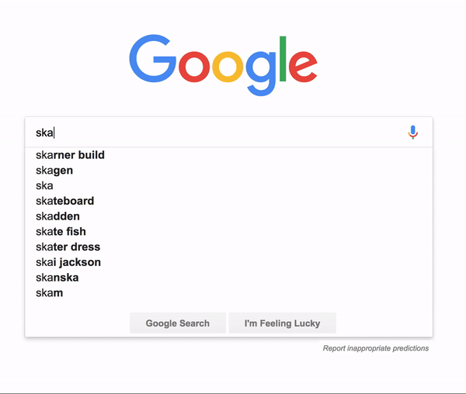
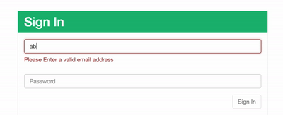
So……What is it?
Games? JavaScript!
Pop-ups? JavaScript!
Dropdown menus? JavaScript!
Todo Lists Apps? JavaScript!
Personalized greetings when you login? JavaScript indeed!

Slide 12
Your Turn!
Activity: Seeing is Believing
Suggested Time: 5 min.
Assignment:
Open the browser and navigate to google.com
Open the dev tools and find the console
Type each command into the console and press “Enter”
Make note of how each command differs…articulate the behavior in your own words
console.log(“hello world”);
alert(“hello world”);
document.write(“hello world”);

Slide 13
Remember…
JavaScript is a programming language.
Programming at its core is about storing and manipulating values in a controlled and ordered manner.

Slide 14
Variables, Values, & Types
Oh My!

Slide 15
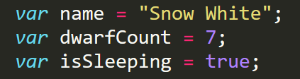
Variable Basics
Variables are the nouns of programming.
They are “things”:
Strings
Numbers
Booleans
Objects
Arrays*
They are composed of names and values.

Slide 16
Primitive Types

Slide 17
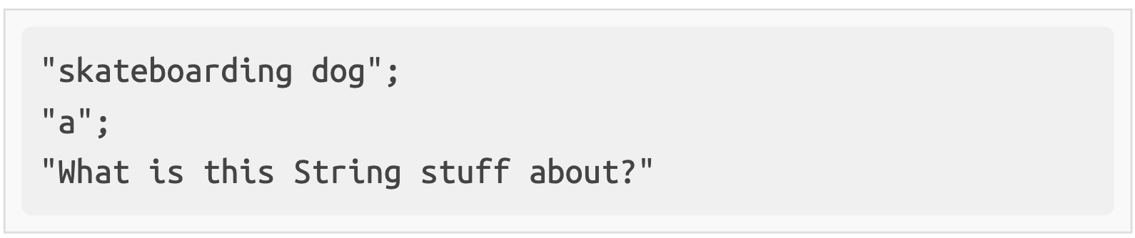
Strings
Strings are collections of characters (think words and sentences).
Like the ones you type in a Google search bar
Quotation marks tell the computer that the value is a String.

Slide 18
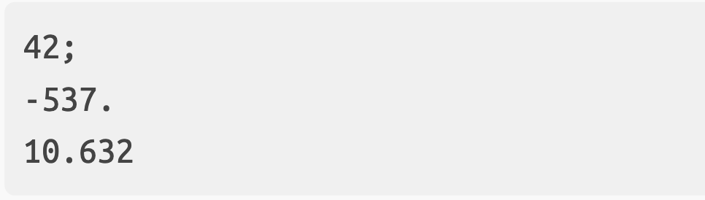
Numbers
Numbers are…numbers…🤯
They can be integers (whole numbers) or decimals.
They can be positive or negative
There are a couple of weird special numbers, but we are not going to worry about those right now.

Slide 19
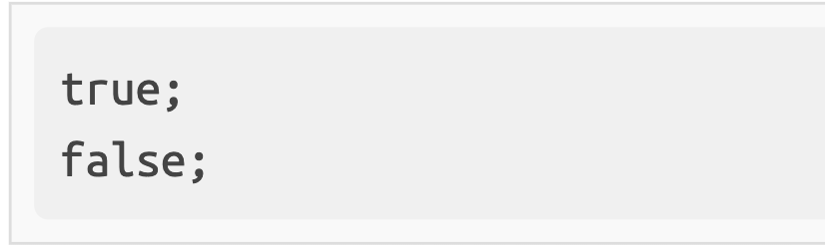
Booleans
Booleans can have 1 of 2 values…true (yes) or false (no)
Analogy - Booleans are like light switches; there are only two possible states, no in-between.
True and False are keywords and, unlike strings, don’t require any special syntax or quotes for the computer to interpret and use them.

Slide 20
Variable Assignment

Slide 21
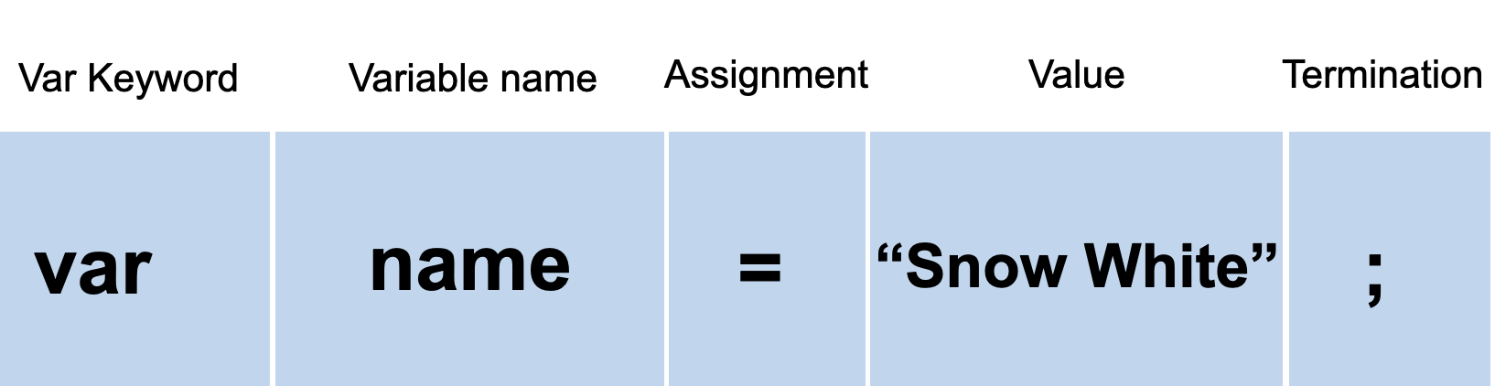
Variable Basics (Syntax)
Be sure to notice the quotes (“”),
which convey that Snow White is a string.

Slide 22
Demo

Slide 23
Your Turn!
Activity: Variable Assignment
Suggested Time: 10 min.
Assignment:
Using the instructions in the `index.html` file, fill in the missing JavaScript code to create variables.
When you are done, open the file in Chrome and check the output.
If you successfully completed the activity, you should see a series of pop-up windows with text inside.
Finally, look at the rest of the code and try to figure out why the text displayed the way it did.

Slide 24
Logs, Prints, Alerts

Slide 25
Demo

Slide 26
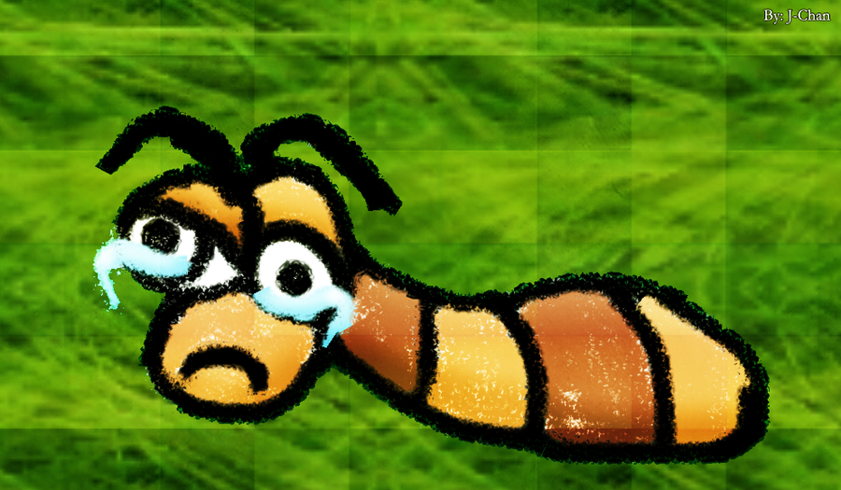
Sad Little Bug…
Hey Class!
How do you comfort a JavaScript bug?
You “console” it!
🥁

Slide 27
Sad Little Bug…
Don’t worry!
It was a hilarious joke…that will make sense later

Slide 28
Your Turn!
Activity: Console vs. Alert
Suggested Time: 10 min.
Assignment:
Using the index.html file as a guide, modify the code so that it logs to the console instead of displaying alert messages to the user.
Think about the differences between the 2 methods and how they might be used in different situations.

Slide 29
Alerts, Prompts, Confirms

Slide 30
Demo

Slide 31
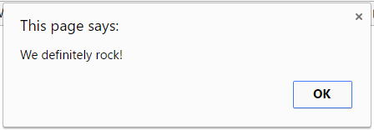
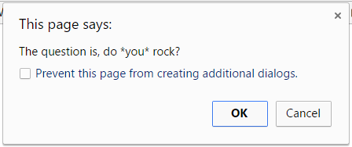
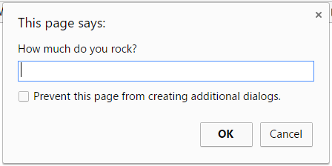
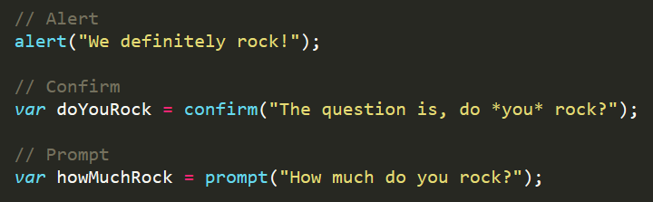
Alerts, Prompts, Confirms
Alerts, Confirms, and Prompts will create a popup box in the browser when run.
These are also useful for development and debugging.

Slide 32
Your Turn!
Activity: Prompts
Suggested Time: 15 min.
Assignment:
Write JavaScript code that does the following:
Using a confirm, ask the user, "Do you like sushi?" Store their response in a variable.
Using a prompt, ask the user, "What kind of sushi do you like?" Store their response in a variable.
Alert both variables to the screen.

Slide 33
Document Write

Slide 34
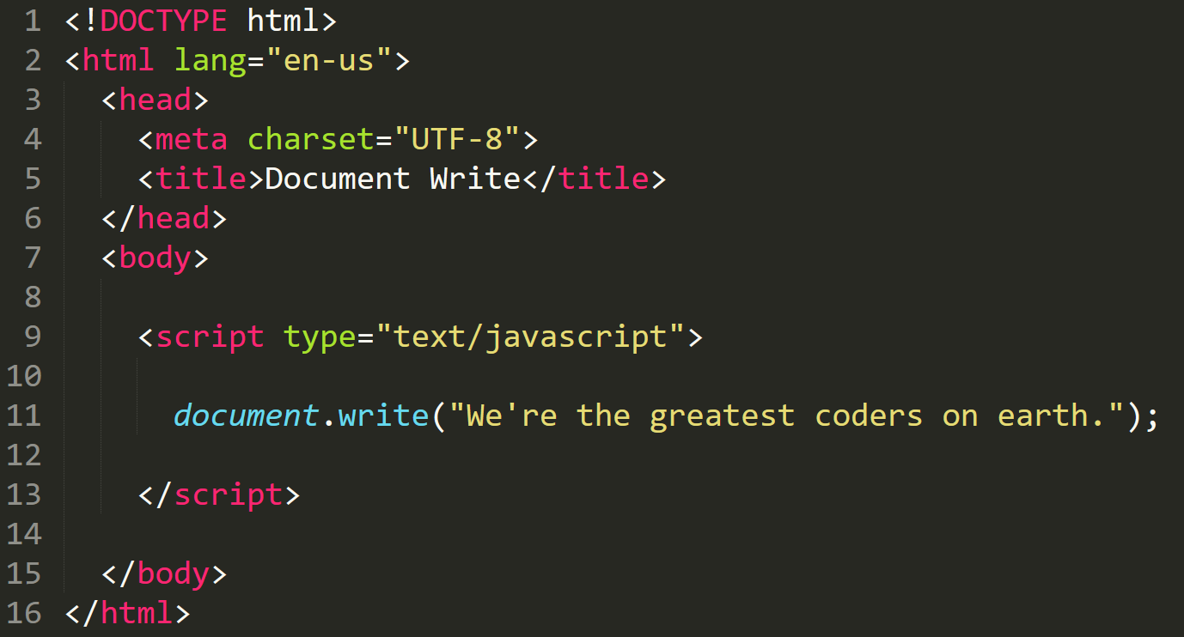
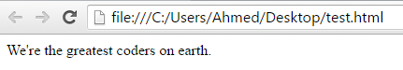
Document Write
We can also use JavaScript to directly write to the HTML page itself using document.write( ).
Later we will go over much more advanced approaches for writing HTML using JavaScript.

Slide 35
If / If Else / Else

Slide 36
Demo

Slide 37
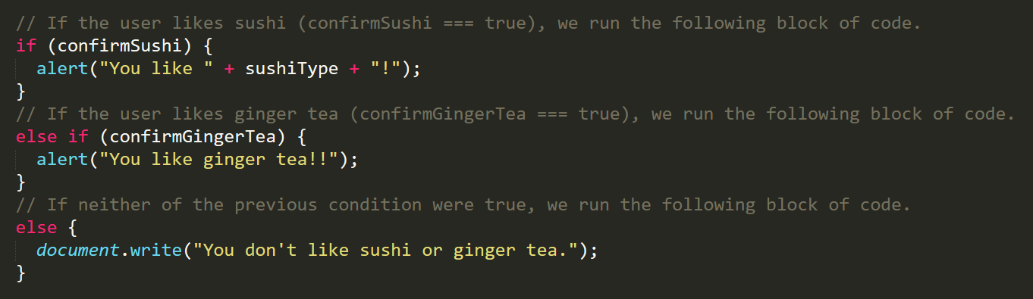
If/Else Statements
If/Else statements are critical to creating dynamic web apps
Each statement is composed of an if, else-if and/or else (keyword), a condition, and the resulting code of that condition in { } (braces or curly brackets)

Slide 38
Your Turn!
Activity: Conditionals
Suggested Time: 15 min.
Assignment:
Create a website (from scratch) that asks users if they eat steak.
If they respond with "yes", write the following to the page: "Here’s a Steak Sandwich!"
If they respond with "no", write the following to the page: "Here’s a Tofu Stir-Fry!"
Bonus:
Ask what the user’s birth year is.
If they are under 21, alert the following: "No Sake for you!”
If they are over 21, alert the following: “Sake Sake Sake!”
If they are 21, alert the following: “You inched by! Sake!”

Slide 39
Your Turn!
Activity: Conditionals Cont.
Suggested Time: 15 min.
Assignment:
Open the file in the class repo
Together, lets go through and predict what the result of each “conditional” statement will be.

Slide 40
Compound Types

Slide 41
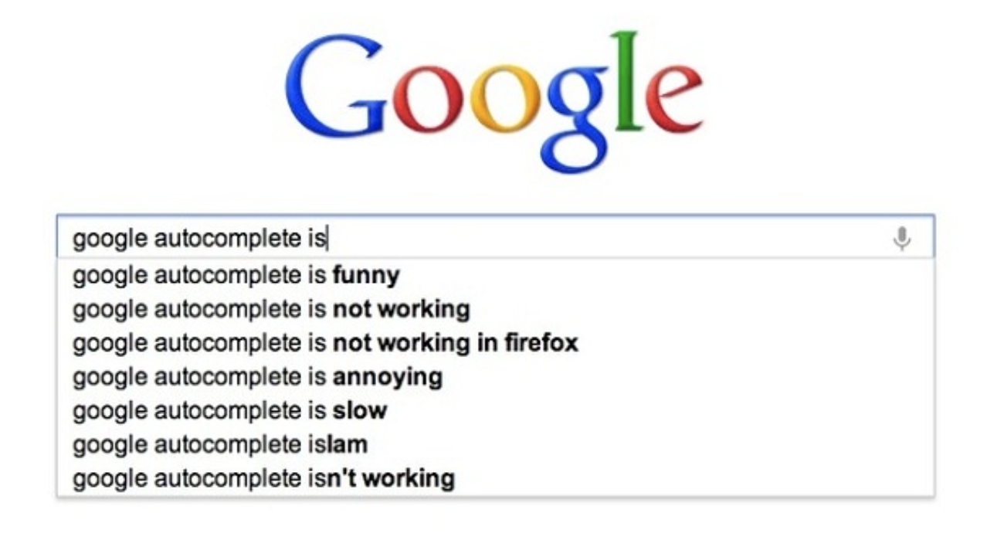
Arrays
Arrays are a list of things
Like the list of search suggestions you see in Google search as you type

Slide 42
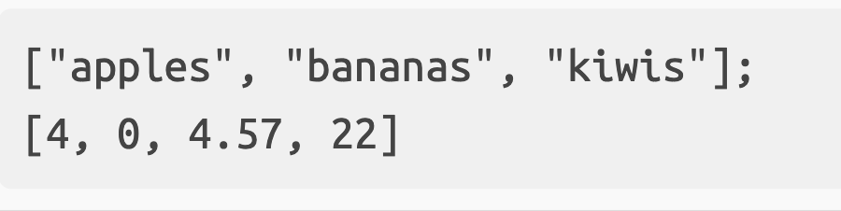
Arrays
Arrays are identified by brackets ([ ]) and the elements within an array are separated by a comma (,)
Arrays cam hold lists of any type of value (strings, numbers, etc…., even other arrays)

Slide 43
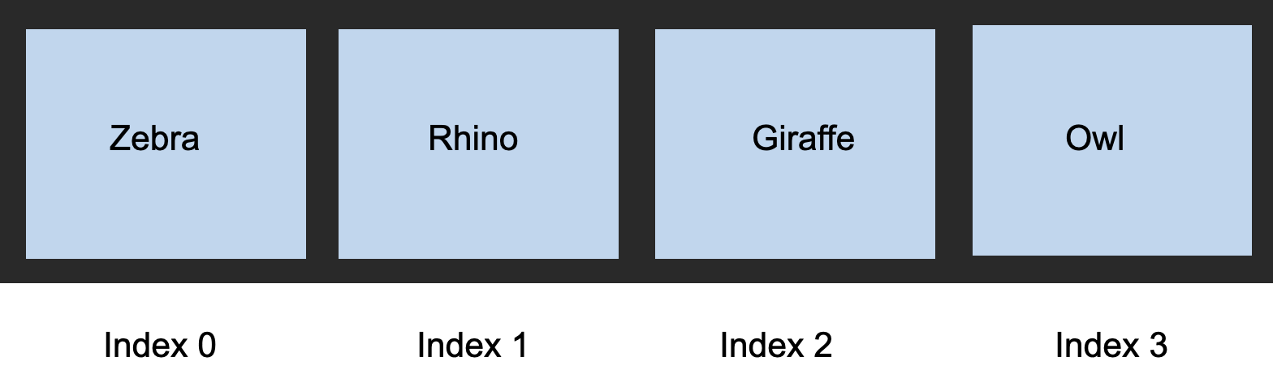
The Zoo Pen
Items in an array are identified by their index.
This is a number that determines where in the array they are located.
Indexes (i.e. indices) are 0-indexed.

Slide 44
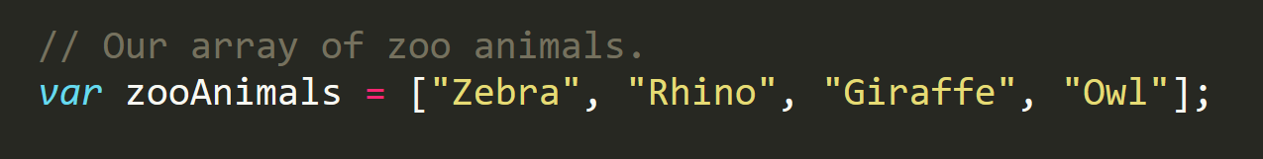
The Zoo Pen (Coded)

Slide 45
Demo

Slide 46
Your Turn!
Activity: Arrays
Suggested Time: 15 min.
Assignment:
Take a few moments to look over the code in the file
Above each console.log(), write a comment predicting what the output will be.

Slide 47
Your Turn!
Activity: Arrays Cont.
Suggested Time: 15 min.
Assignment:
Create a website that accomplishes the following:
Create an array of your favorite bands
Prompt the user for their favorite band.
If it is one of your favorites, alert: “YEAH I LOVE THEM!”
If it is NOT one of your favorites, alert: “Nah. They’re pretty lame.”

